Slide 1
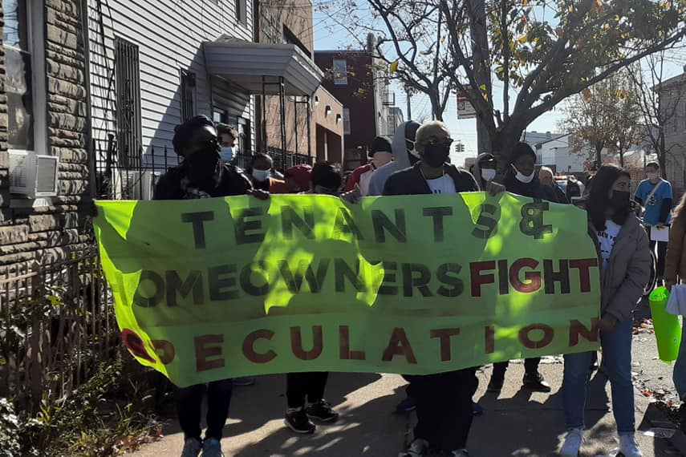
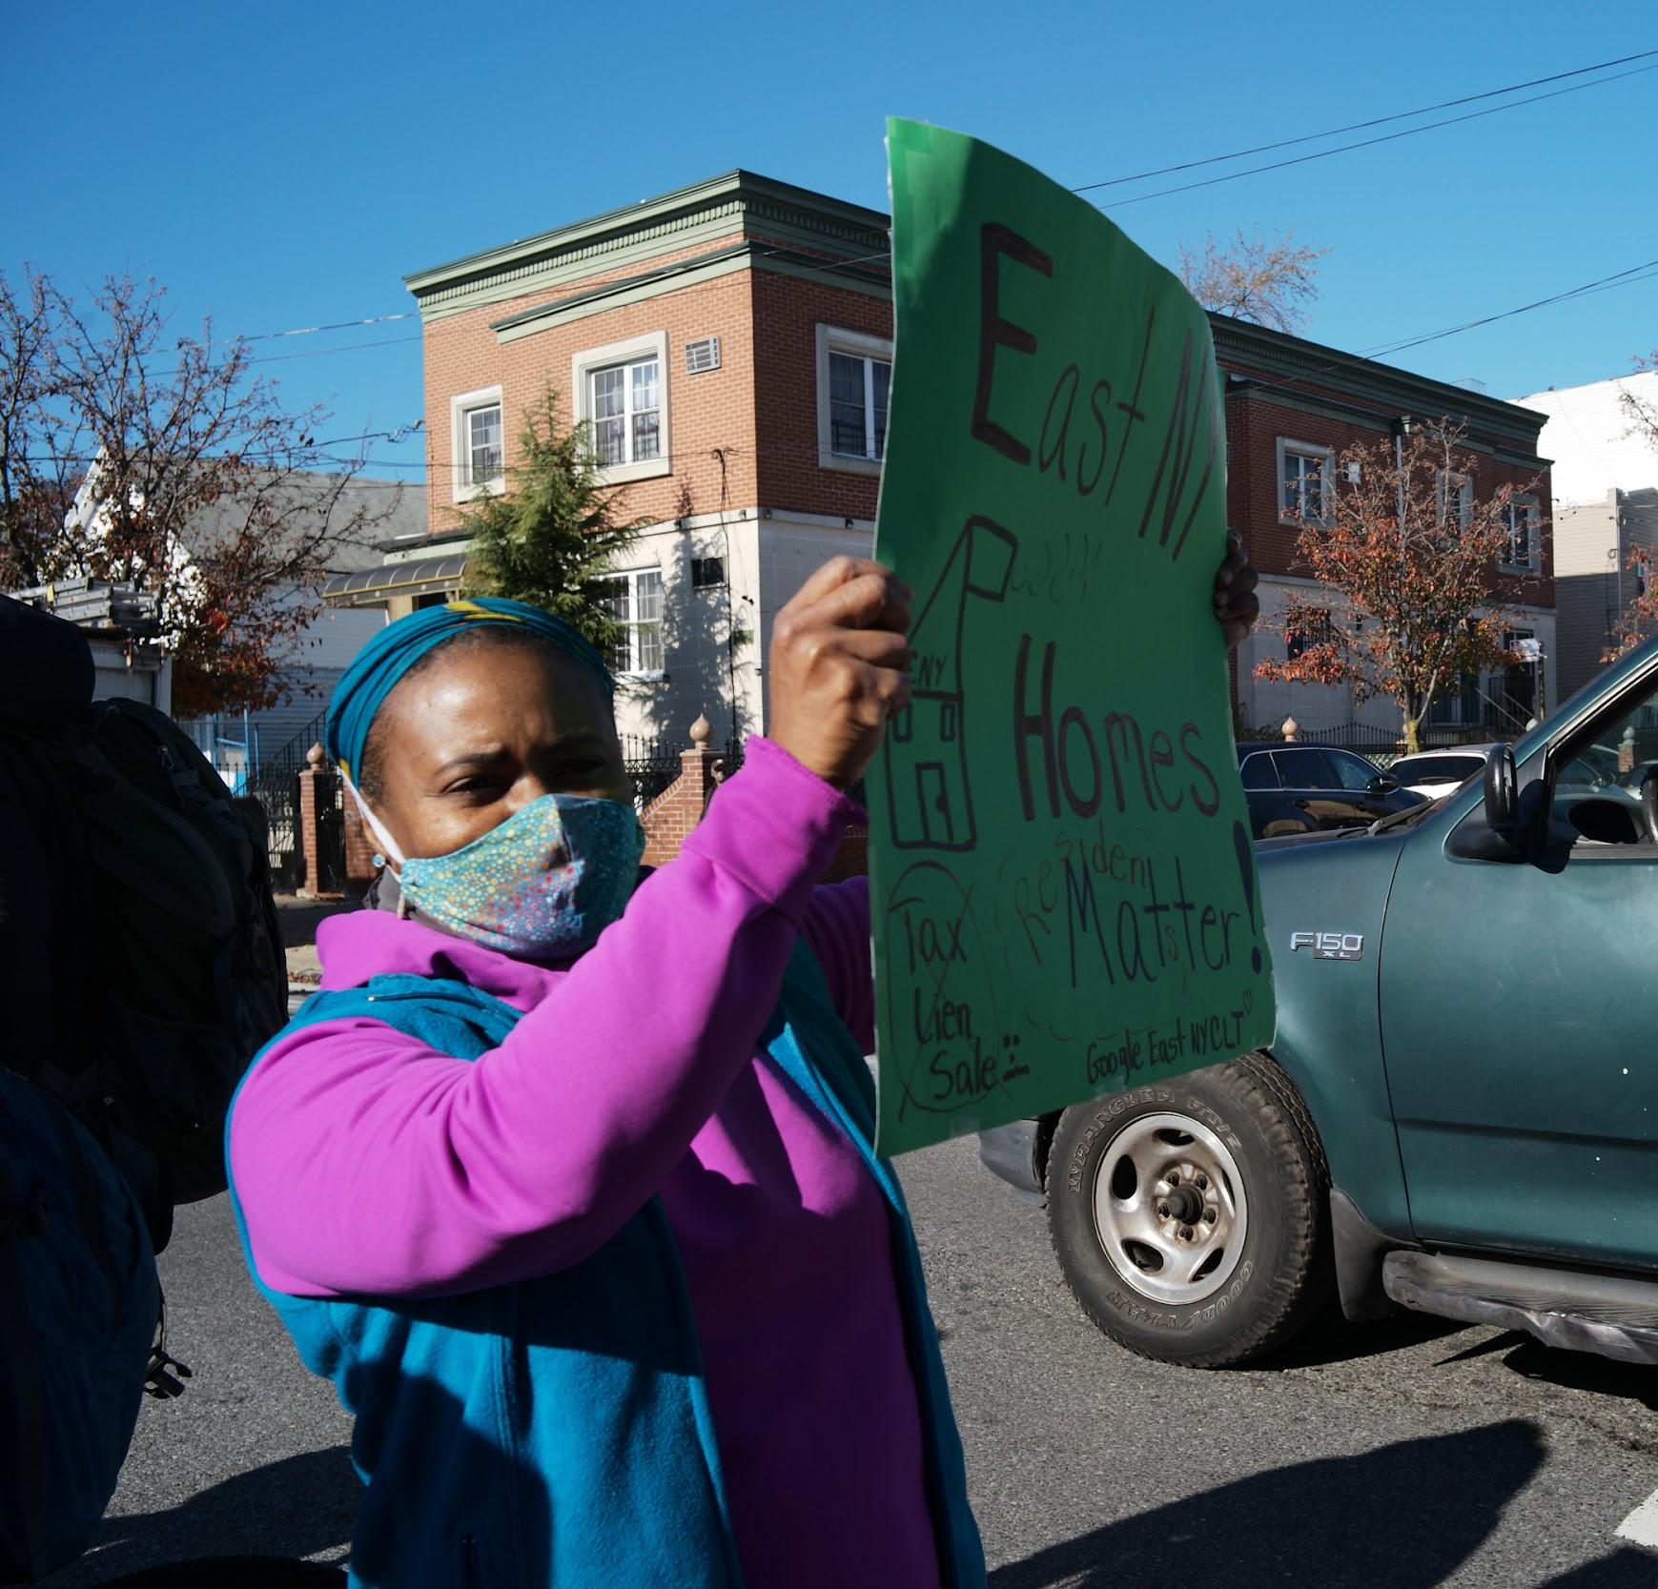
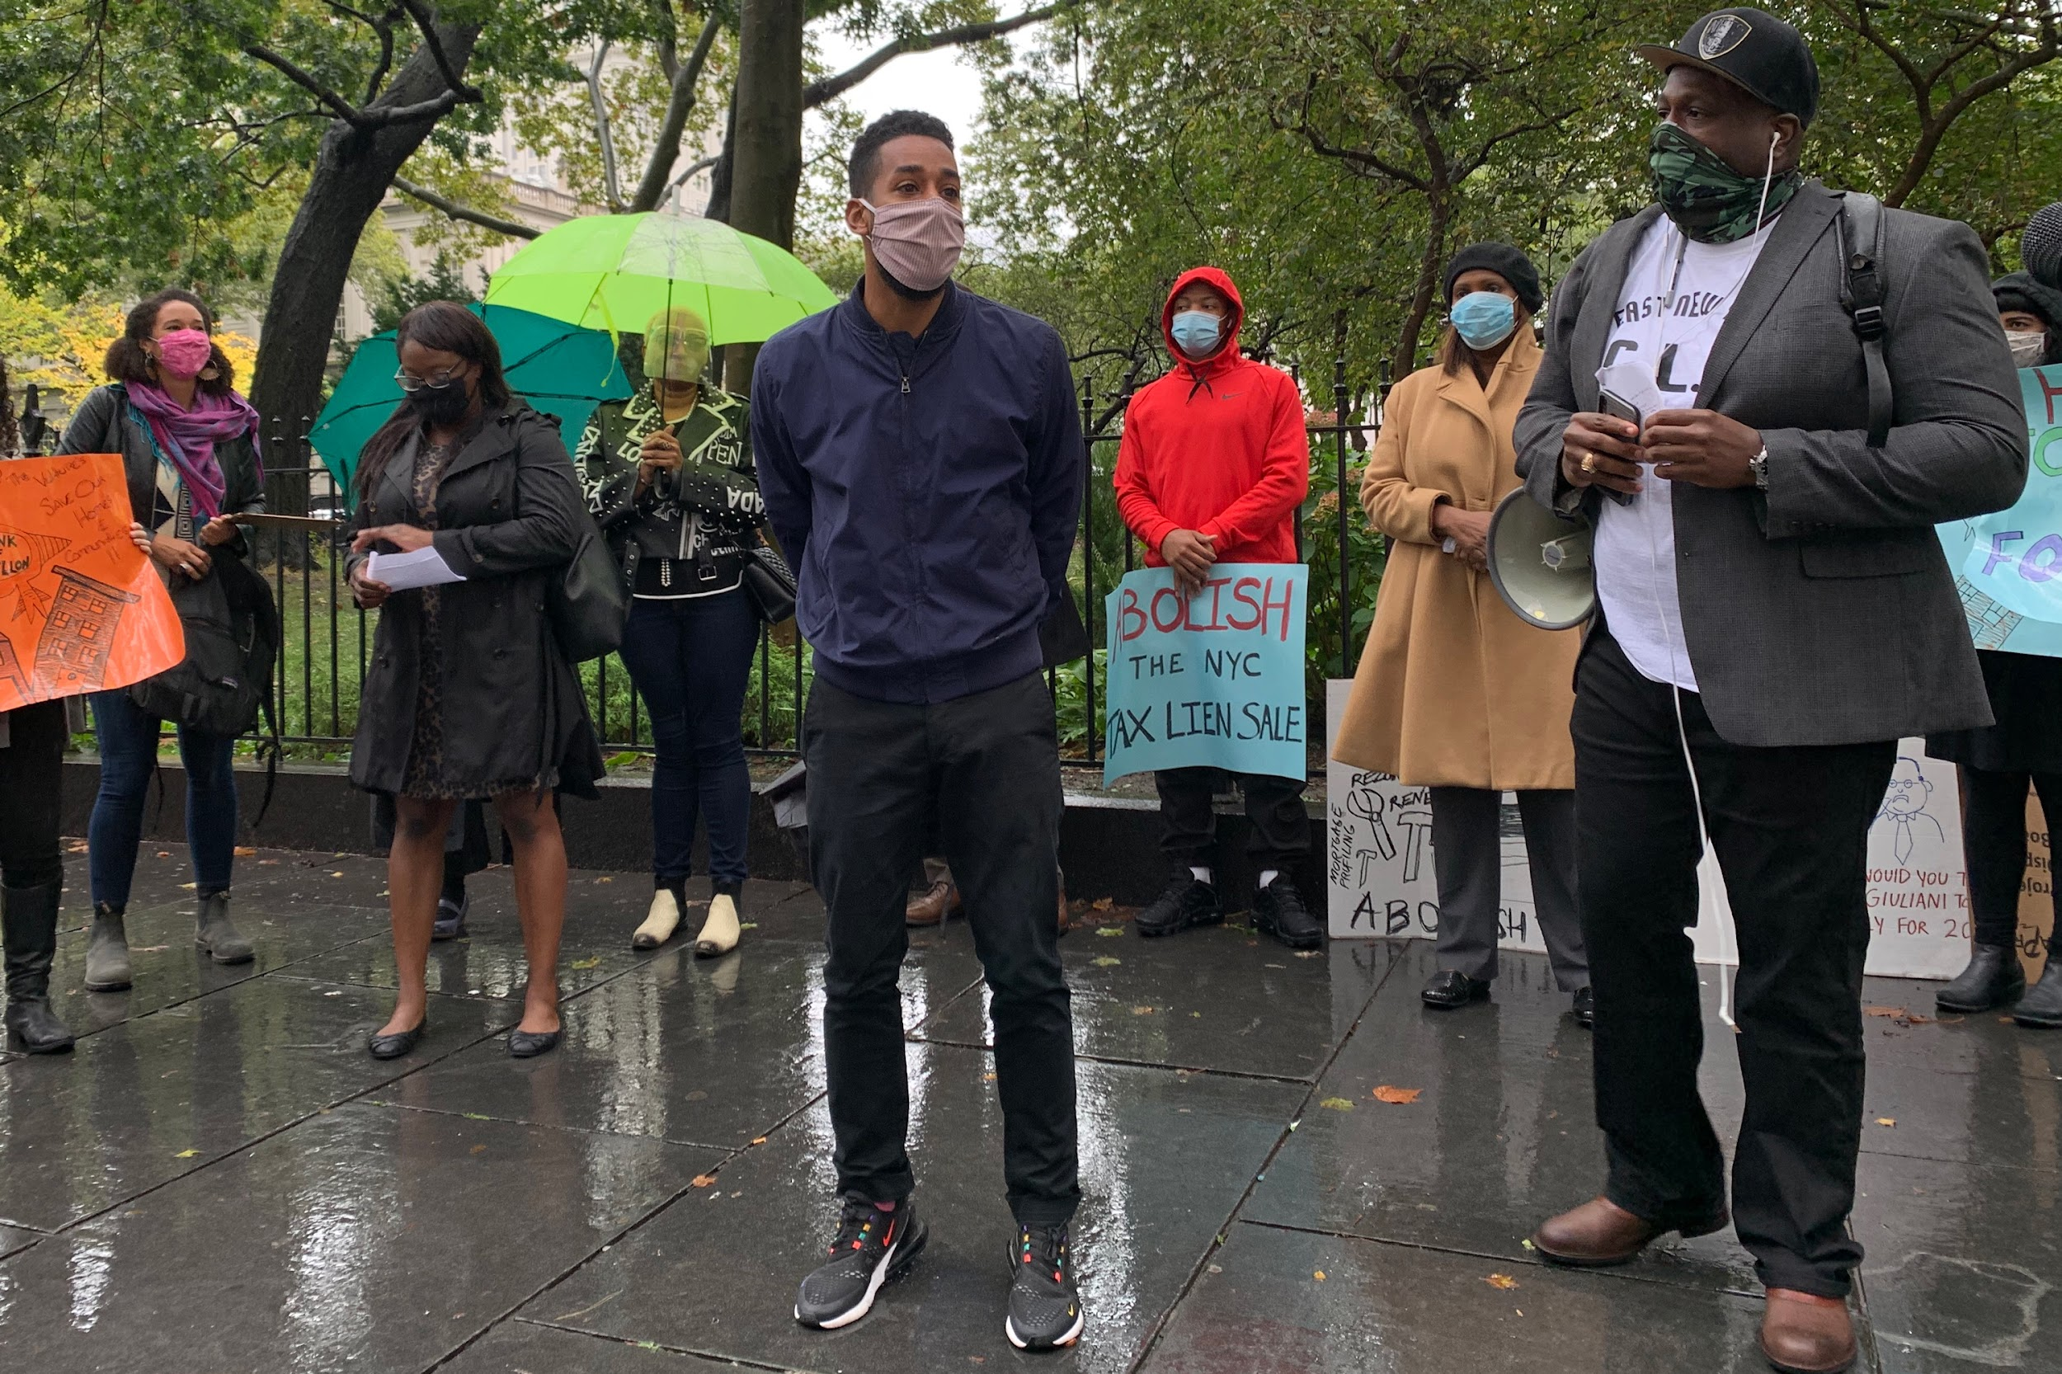
Hello from the Abolish the NYC Lien Sale Coalition
Notes:
Debra We are part of coalition of 10 organizations from around New York City
We held workshops and roundtables to educate the community about the tax lien sale and to build consensus about how to replace it.
Hearing from people about its negative impacts, we developed a campaign to replace the lien sale altogether
We held press conferences and rallies to push City Council and the Mayor to abolish the lien sale

Slide 2
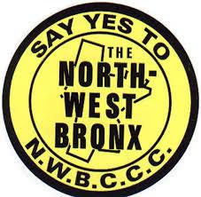
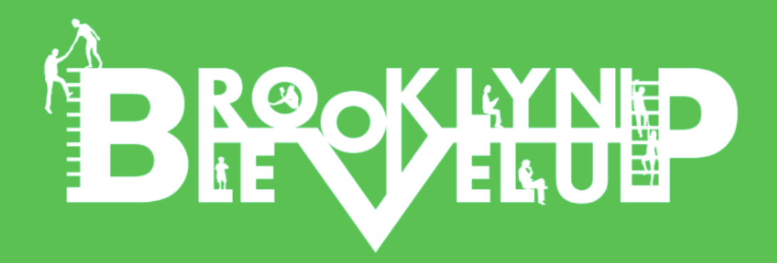
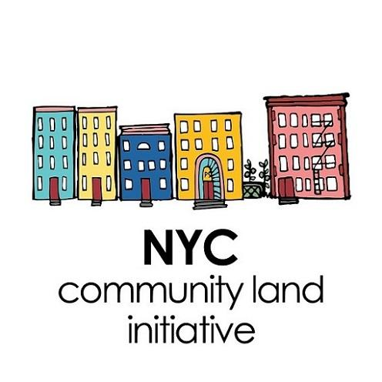
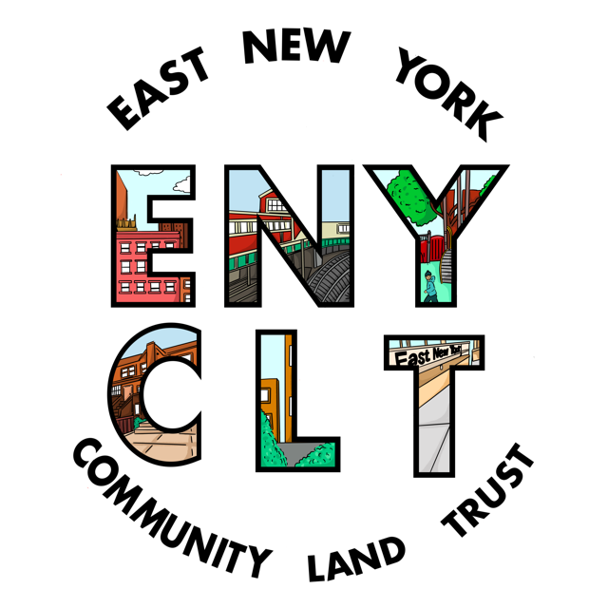
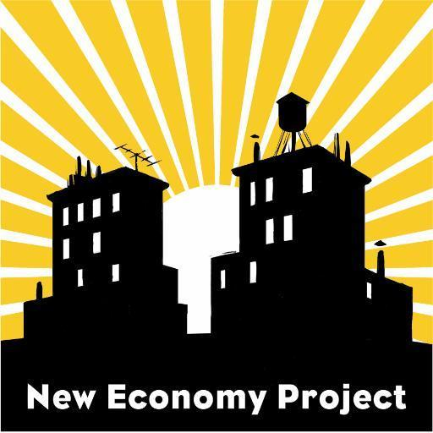
Hello from the Abolish the NYC Lien Sale Coalition
Notes:
Debra
We are part of coalition of 10 organizations from around New York City
We held workshops and roundtables to educate the community about the tax lien sale and to build consensus about how to replace it.
Hearing from people about its negative impacts, we developed a campaign to replace the lien sale altogether
We held press conferences and rallies to push City Council and the Mayor to abolish the lien sale

Slide 3
Notes:
Debra

Slide 4
Notes:
Elise

Slide 5
Notes:
Paula

Slide 6
Agenda
Introductions
Agenda
What’s a Community Land Trust?
History
Core elements
CLTs in NYC
The moment we face
The NYC Tax Lien Sale
How does this system work now?
Who does it harm?
How can we change it?
CLTS as part of the long-term solution
Tax lien sale deadlines coming soon!
Notes:
Paula

Slide 7
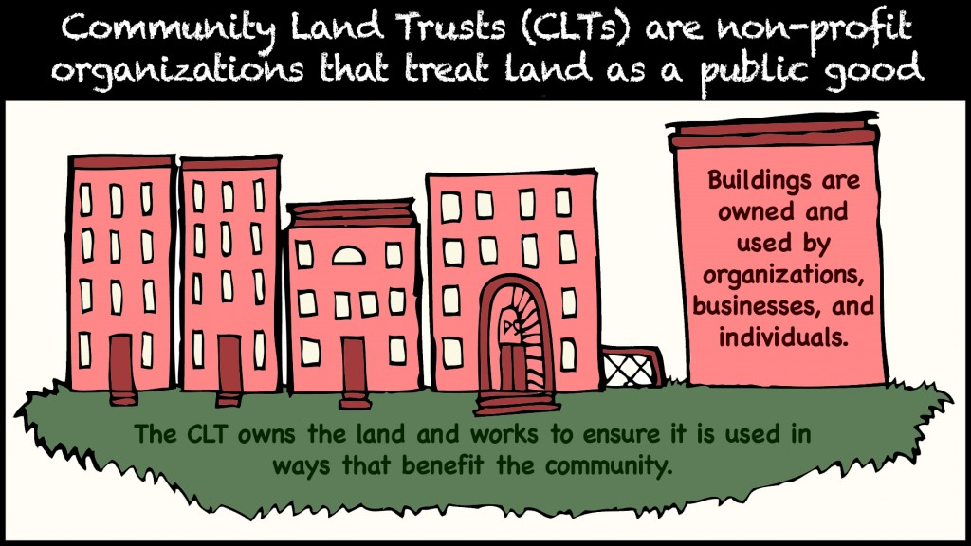
What’s a Community Land Trust?
Notes:
Elise But what does it mean to “steward” land? It means to make collective decisions about its use for the good of a community and to build community around these decisions.
Buildings on the land--which can include affordable housing as well as small businesses, urban gardens and farms, community centers, and more--are individually owned or rented, and lease the land underneath through a 99-year, renewable ground lease. This split ownership takes land off the speculative market, while the 99-year ground lease guarantees permanent affordability and lays out income restrictions and other terms.
The ground lease sets out the collectively-decided terms of what can and can’t be done with the land, and the by-laws, which set out how the CLT should make decisions, whose interests are represented and how, and what the board is responsible for doing.

Slide 8
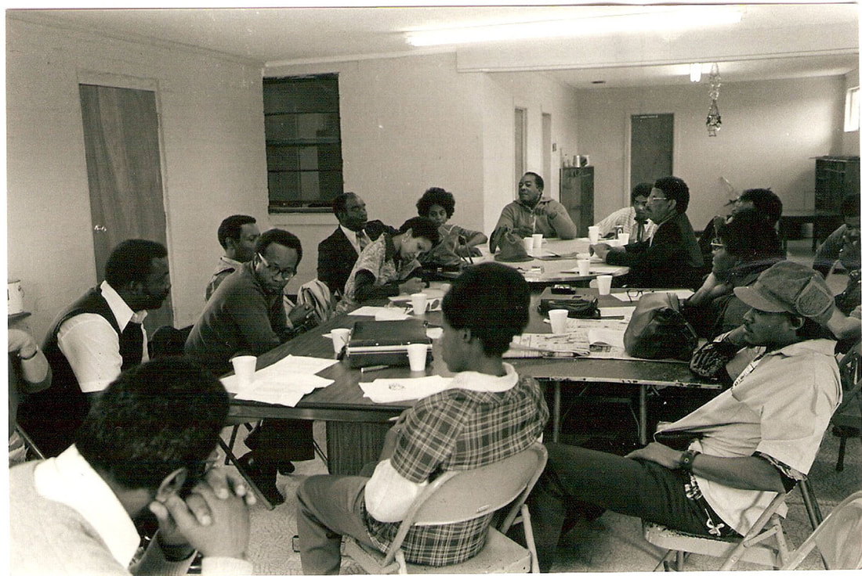
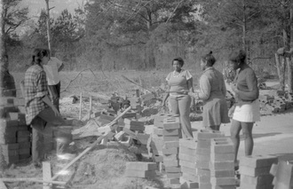
History of CLTs
Notes:
Elise CLTs have long roots in the racial justice movement. The first CLT was New Communities, Inc., developed in Albany, Georgia in 1969 to be a collective farm, especially for Black tenant farmers who had been evicted for civil rights movement activity in the area. An excellent documentary, Arc of Justice, relates New Communities, Inc.’s 50-year fight for justice after having been consistently undermined by racist state and local authorities and the federal government.

Slide 9
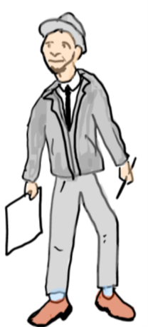
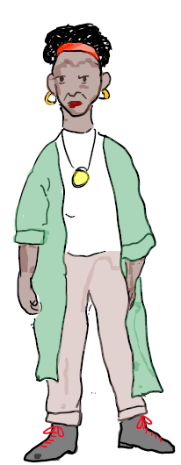
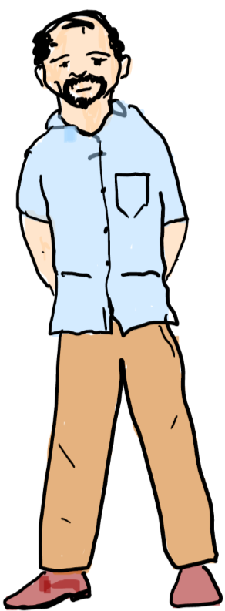
Tripartite board and interests
Representatives of organizations or others who can help steer the group
Residents
Other neighbors
Notes:
Elise Because CLTs are responsible at the same time to the current users of the land it owns, and to the larger community where the land is, and to future users and community members, it makes sense that most CLTs have what is called a “tripartite” board.
There are three groups that are usually represented on a CLT board:
Current users, whether these are tenants, homeowners, businesses, gardeners, etc. The idea is that they are going to bring in the interests of those using the land now.
Other community members with an interest in the CLT. The idea is that they would bring in the interests of people who want to see the CLT expand in scope and into the future.
A group of “others”--often technical assistance providers or other people with specific skills that can help the CLT be stable enough to last into the future, and who might be able to help resolve disagreements between current users and community members.
How this actually takes shape depends a lot on each CLT’s development process and particular local circumstances. But what is most important to emphasize here is that a CLT focuses on the long-term needs and wants of a community, and is far more than an organization that issues a ground lease to users.

Slide 10
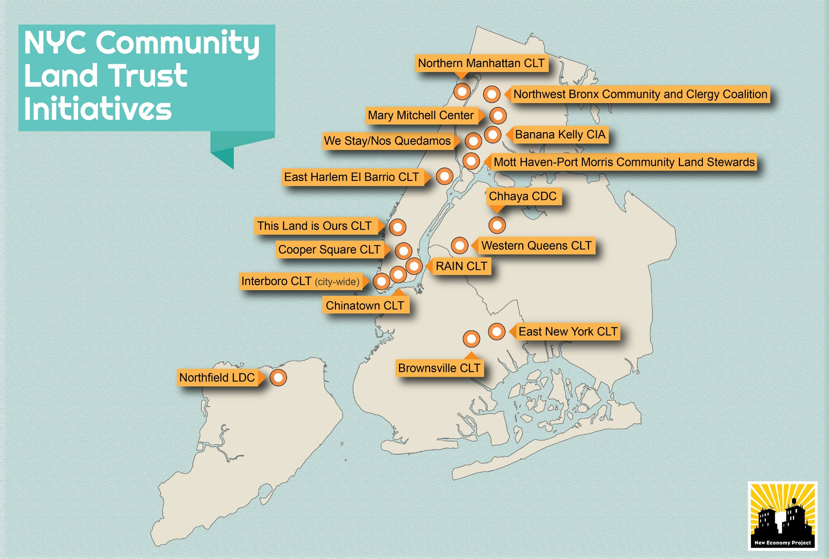
Notes:
Elise

Slide 11
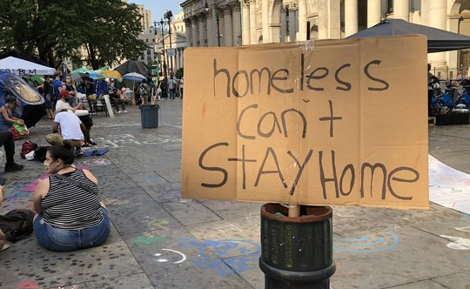
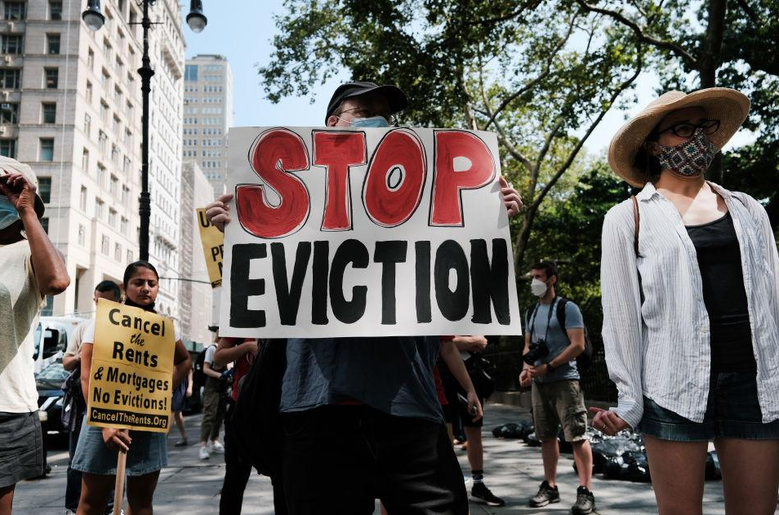
The moment we face
Historic transition in city government
Two-thirds City Council turnover and a new mayoral administration
Longstanding housing and speculation crisis
Ongoing pandemic and recession
This is a moment of grave challenges and great opportunities.
Notes:
Debra

Slide 12
Tenants and homeowners are struggling, and city policy is making it worse.
Around the city, but especially in communities of color, small homeowners are struggling to pay their municipal bills and tenants are struggling with bad conditions and absentee landlords. Meanwhile, empty lots sit vacant as speculators flip them for profits without building a thing.
Instead of designing a system to fix these problems, for the past 25 years the city has outsourced core functions of government and distanced itself from it duties.
Low-income renters and homeowners, seniors and communities of color have suffered as a result.
Tenants and homeowners are at risk! Last week, the city announced that it will be doing a lien sale in 2021, which could affect over 11,000 properties.
Notes:
Debra

Slide 13
The Current Lien Sale System:
What Happens When a Property Owner Doesn’t Pay Their Taxes on Time?
Notes:
Paula

Slide 14
What Happens When a Property Owner Doesn’t Pay Their Taxes on Time?

Slide 15
What Happens When a Property Owner Doesn’t Pay Their Taxes on Time?

Slide 16
What Happens When a Property Owner Doesn’t Pay Their Taxes on Time?

Slide 17
What Happens When a Property Owner Doesn’t Pay Their Taxes on Time?

Slide 18
What Happens When a Property Owner Doesn’t Pay Their Taxes on Time?

Slide 19
What Happens When a Property Owner Doesn’t Pay Their Taxes on Time?

Slide 20
Who benefits from this system?
Investors in the Trust who make money at several points in the process:
through service fees;
through high and compounding daily interest rates;
and by sometimes by selling properties they foreclose.
City politicians and agencies who get to deny responsibility for damages caused by the lien sale
Bad landlords who are not deterred by liens and fines because they know they can sell their building for a big profit
Notes:
Paula

Slide 21
Who does the current system harm?
Homeowners who want to settle their debts but can’t afford the fines and compounding interest, and might lose their homes
Tenants in buildings whose landlord is using rent to cover debts rather than maintain the housing, who might be displaced
BIPOC communities where more and more properties -- including owner-occupied homes, rentals, and vacant lots -- are in disrepair because of this predatory system
Working class people who need long-term affordable housing in their neighborhoods
Notes:
Paula

Slide 22
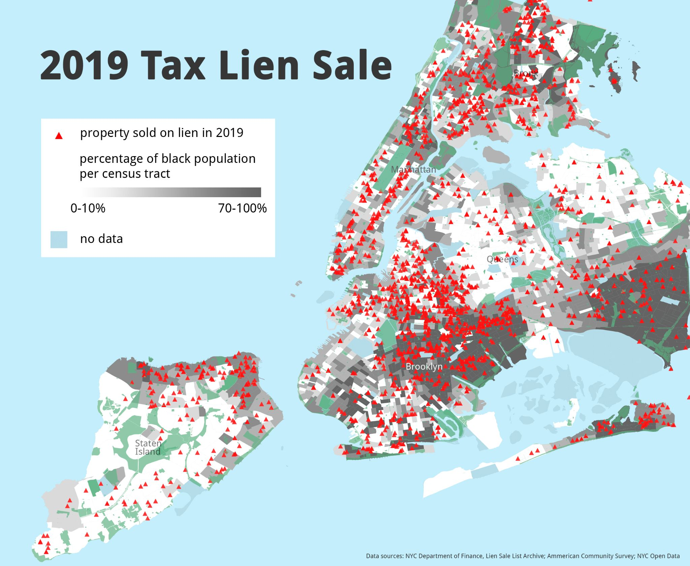
Many of the 3,514 properties on the 2019 sale are clustered in working class BIPOC communities
Notes:
Debra

Slide 23
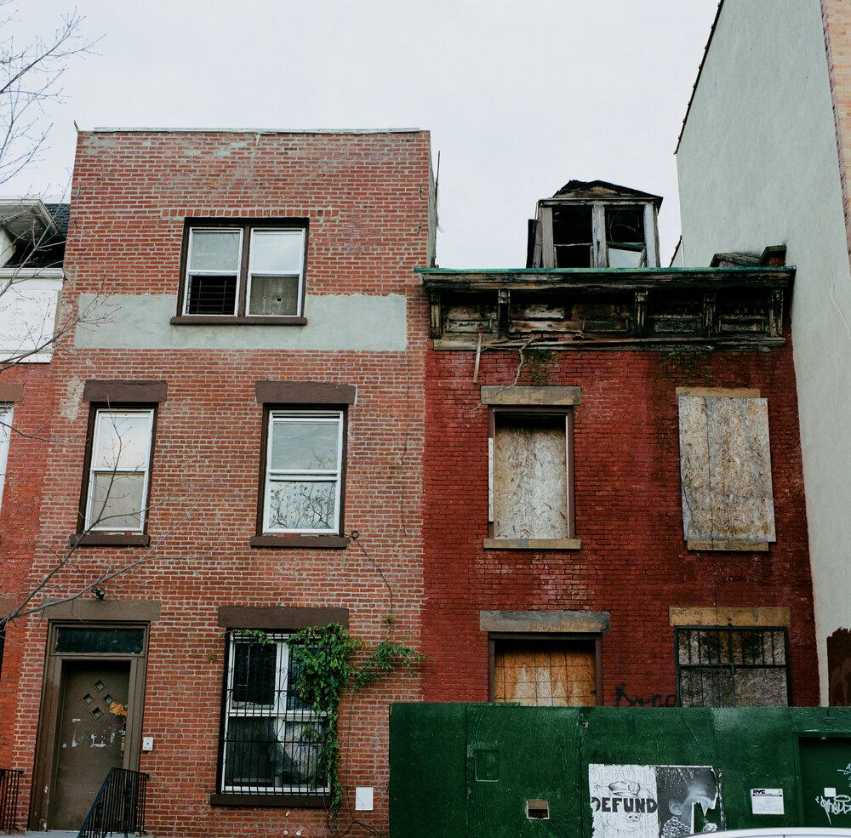
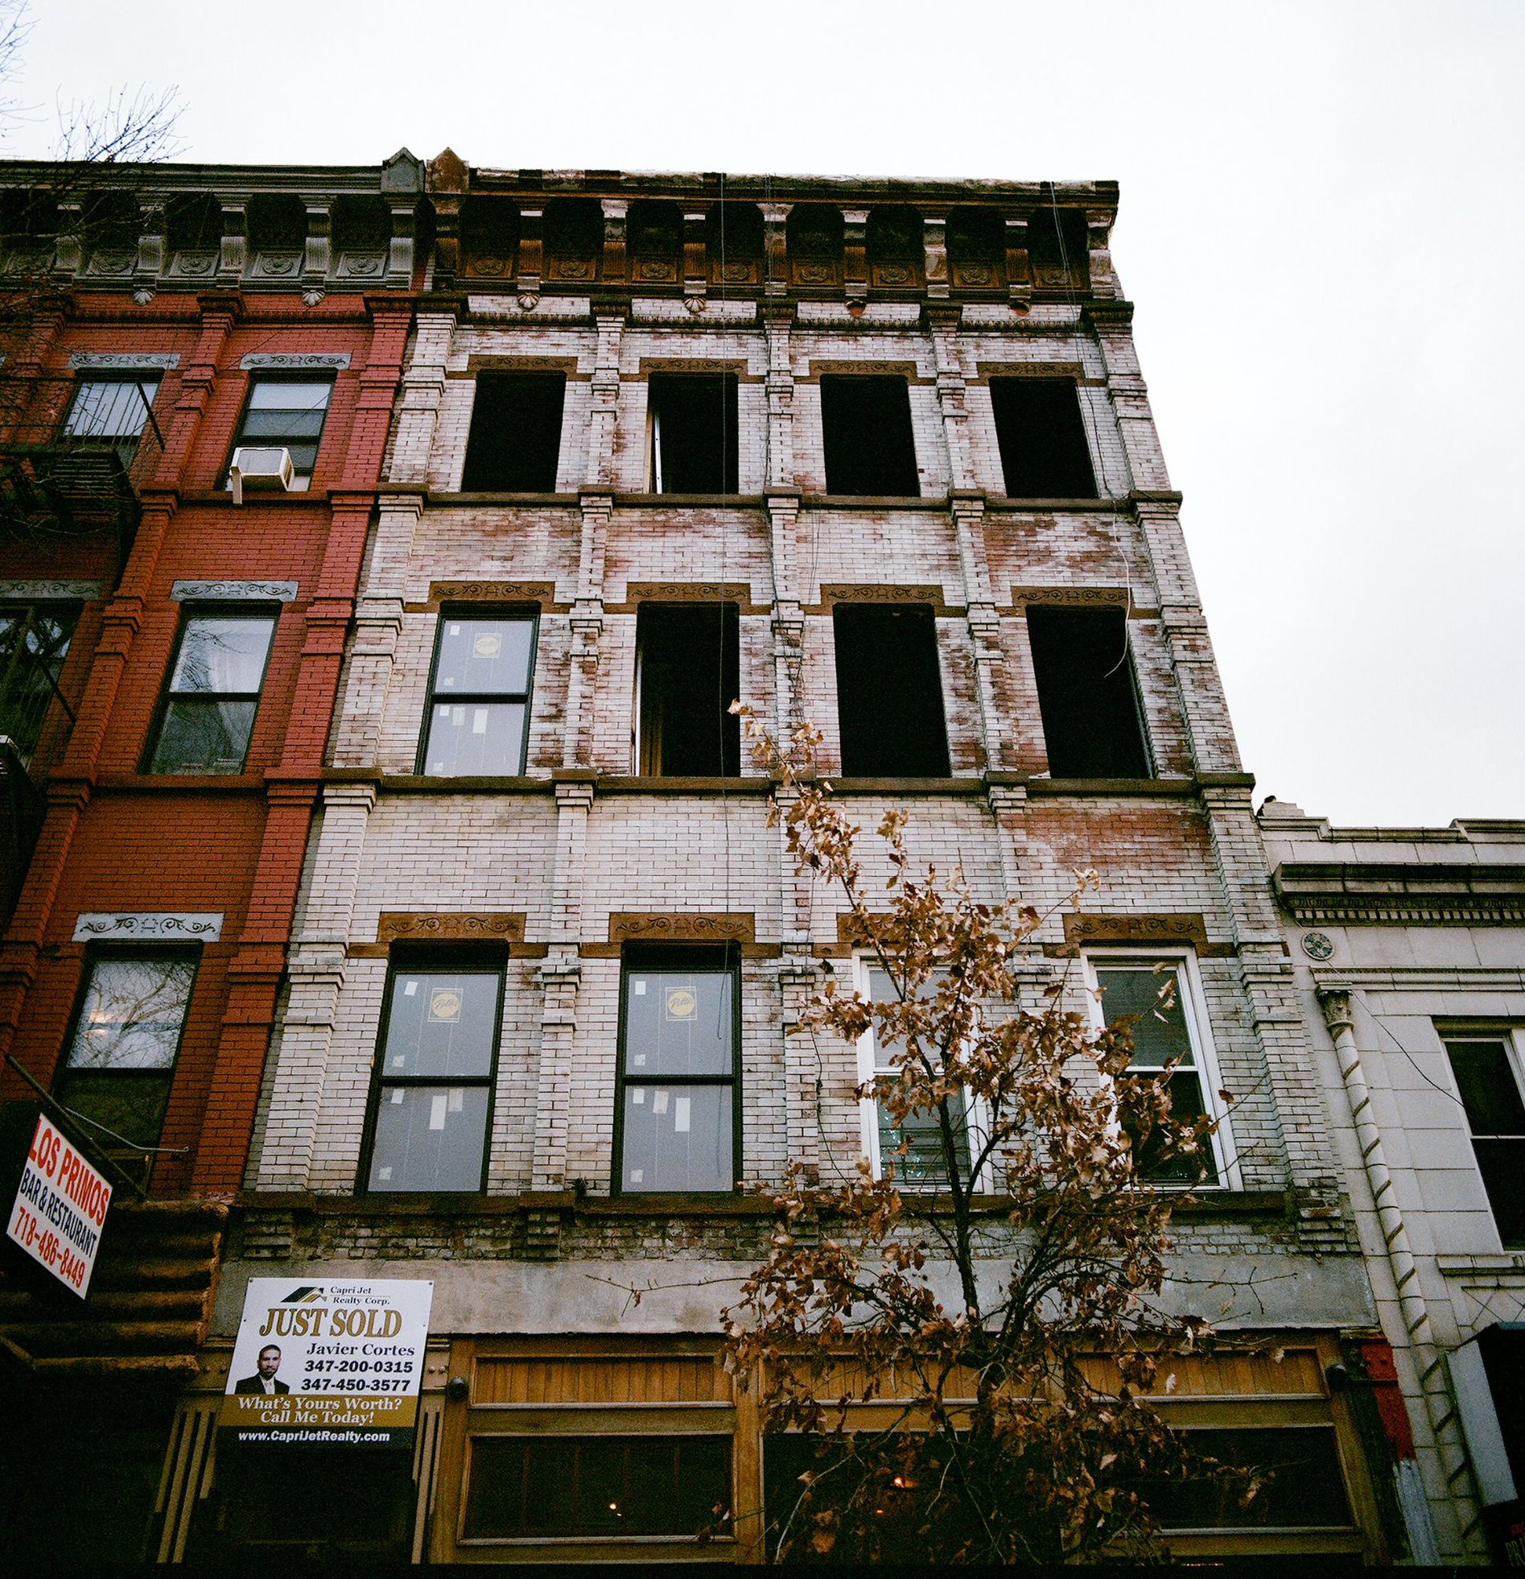
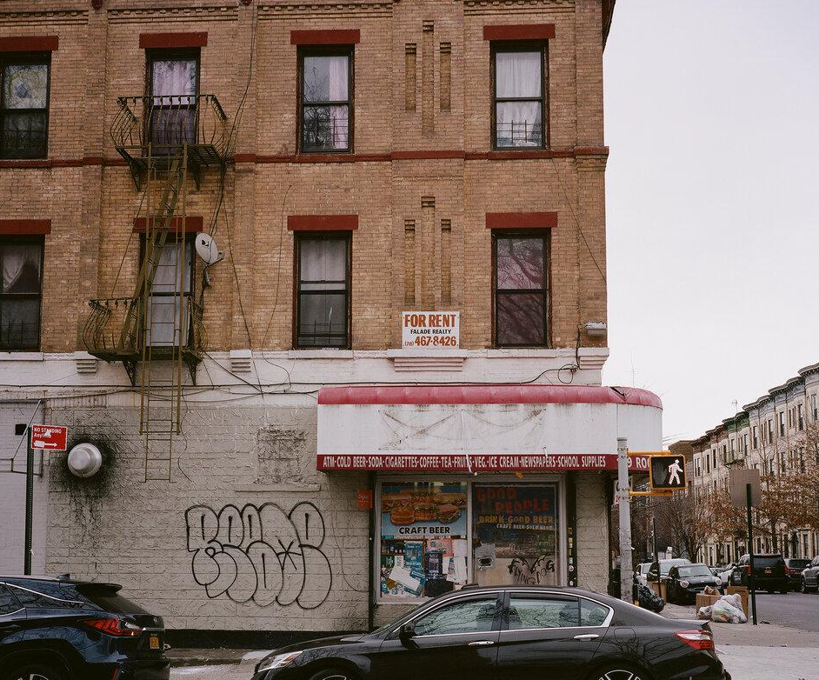
Tax lien sales worsen conditions for tenants
In rental apartment buildings, we often see the following:
Landlords take on big debts and have intense pressure to pay them back.
They often cut back on basic building maintenance to reduce expenses, or harass and evict tenants to raise rents.
Eventually they fall behind on bills and end up up in the tax lien sale.
When the city sells those liens, we lose the ability to do hold the landlord accountable. Instead, we could either help good landlords fix the building, or take the building away from abusive landlords and preserve them through CLTs.
Notes:
Elise In Brooklyn, multifamily buildings with four or more liens sold between 2014 and 2019 had an average of about 17 building violations per unit filed with the city’s Department of Housing, Preservation and Development, compared to the city average of .7 per unit.
Out of the 734 multifamily buildings that had liens sold in 2019, more than a third of them had a lien sold at least one other time since 2014.
An analysis by THE CITY found that in the six years between 2014 to 2019, 881 multifamily buildings citywide had liens sold multiple years, and 429 of those buildings were in Brooklyn.
where a non-bank lender's high-cost financing put intense financial pressure on the borrower to provide a return on their investment, which resulted in hazardous conditions and displacement of tenants,

Slide 24
This sounds awful. Why does this system exist?
Long story short: it was a right-wing think tank’s dream, and Rudy Giuliani adopted it for New York City. Even though no other city works this way, Giuliani’s system still operates here 24 years later.
Notes:
Paula

Slide 25
Do we need a tax lien sale?
NO!
Notes:
All of us!

Slide 26
So the tax lien sale is bad and unnecessary. What should we do instead?
Step 1) Abolish the tax lien sale
Step 2) Establish an equitable property tax collection system with the goals of:
keeping tax delinquency rates low
preventing displacement
curbing speculation
improving conditions for tenants
promoting community ownership
preserving and developing affordable housing and public space
Step 3) Ensure that public-sector workers and community organizers have the resources they need to secure just outcomes.
Notes:
Elise

Slide 27
Sounds good. What’s your plan?
The DOF should do more robust and sustained outreach to small property owners in debt and make it easier for them to apply for exemptions
The City should work with local community land trusts (CLTs) to present small property owners with the option to forgive their debt and keep their home in exchange for putting their land in a CLT.
If a property owner doesn’t accept any of these options, the city can eventually foreclose on the properties. However, instead of selling the properties to the highest bidder (usually speculators) at auction, the city must transfer the properties to CLTs and other community-based organizations.
Notes:
Paula

Slide 28
What we’ve won so far:
In 2021, we successfully organized to:
Limit the reauthorization of the Tax Lien Sale to just one year
Secure public funding for outreach and education to those affected by the lien sale
Exempt small property owners (of less than 10 units) suffering hardships related to COVID-19
Reduce the number of other properties eligible for the lien sale by lifting the threshold of debt that makes an owner eligible for sale
Task Force of city agencies, council members and community stakeholders to design alternative methods of addressing delinquent property taxes and City service fees (including Debra Ack from the ENYCLT)
Notes:
Debra

Slide 29
Next Steps - 2021 Lien Sale
The administration is planning a lien sale for December 17, despite opposition from City Council members and Eric Adams’ saying he opposes the lien sale.
Let the mayor know you support the call for cancellation!
Make sure that anyone who you’re connected to that is at eligible for the 2021 lien sale fills out the hardship form if they experienced a COVID-related financial hardship (more on that in a moment)
Notes:
Paula

Slide 30
Next Steps - 2022 and Beyond
Next year, the new mayor and City Council will have to establish their position on the lien sale for after Feb 2022.
The City Council will need to either
a) let the system lapse
b) reinstate the bad old system, or
c) legislate a new and more equitable system like the one we have proposed.
This may be one of the first things facing new elected officials when they take office.
Let your incoming council members know that the tax lien sale must be abolished!
Notes:
Elise

Slide 31
Questions?
Contact us:
staff@eastnewyorkclt.org
646-335-5973

Slide 32
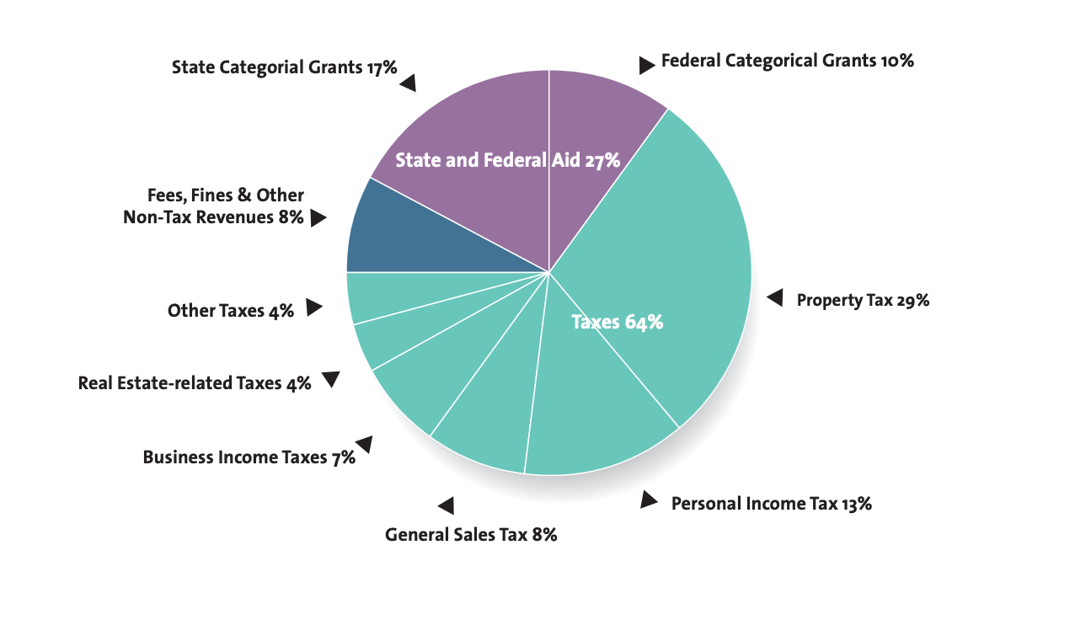
Doesn’t the lien sale generate a lot of revenue for the city?
Not Particularly! Lien sale is 1/459th of the property tax revenue, only $61M in 2019
* In a “normal” year. 2017 budget was $82.2 billion. Source: Independent Budget Office: https://www.ibo.nyc.ny.us/iboreports/understandingthebudget.pdf
Notes:
Paula

Slide 33
Can the city afford this model?
Yes! Our model creates a system for lasting good, rather than lasting harm!
The social cost of accumulating debt, foreclosure, ‘fire sales’, and other side effects of the lien sale is a tremendous cost to the city.
Preserving existing affordable housing is more cost effective than building new units:
Rehab programs allocate $44,000-$120,000 per unit, significantly less than the estimated $400,000 cost to build a new unit of affordable housing ($500 cost per sq ft/800 sq ft unit), allowing for deeper affordability
CLTs preserve subsidies: For example HPD’s HomeFirst Down Payment Assistance Program subsidy (up to $40K for down payment) is lost after a 10-year period when the homeowner resells at market value. With CLT resale formulas, the subsidy can be retained for next LMI homeowner, multiplying the impact of the initial subsidy.
Debt forgiveness in exchange for transferring land to CLTs is a cost effective way to subsidize permanent affordable housing for current resident and future residents, without losing subsidy to the market after a given time period.

