Slide 1
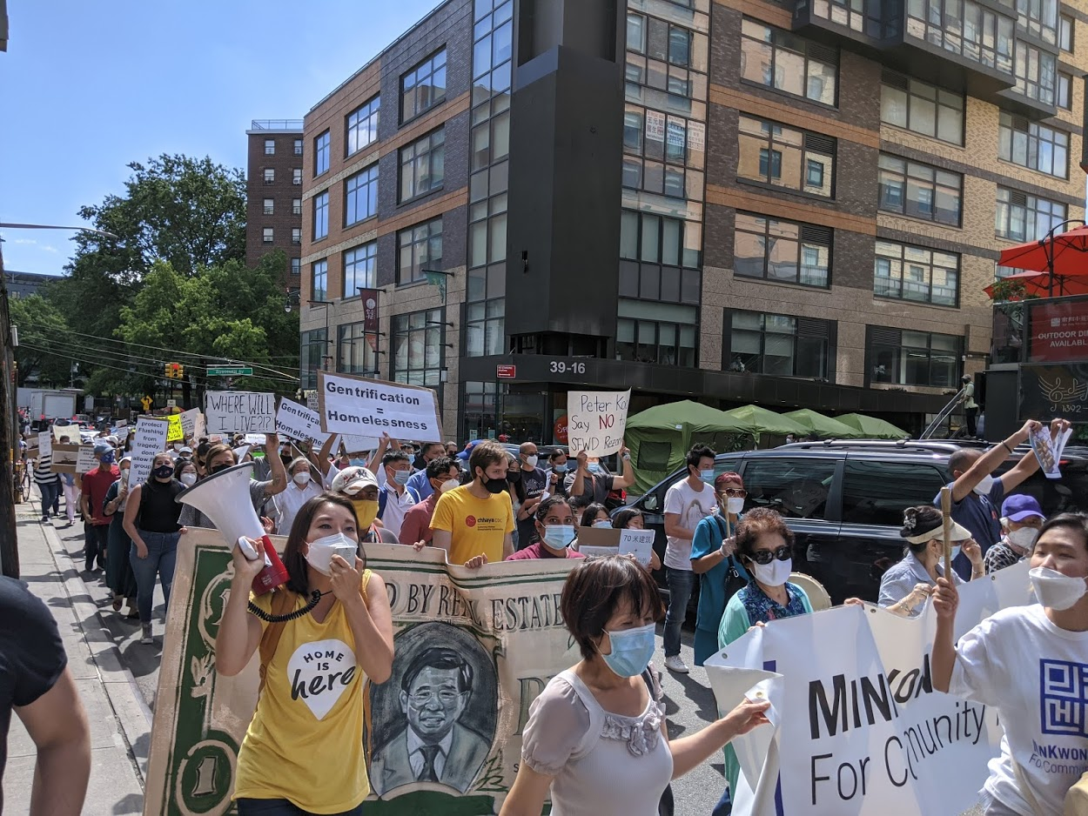
HARASSMENT BY LANDLORDS
October 6, 2022
with Gale Brewer, District 6
Cora Metrick-Chen
April 26, 2024
with Housing Court Answers
Notes:
Cora

Slide 2
What's landlord harassment, to us?
"Many landlords illegally harass and intimidate low-income and rent-stabilized tenants to drive them out in favor of higher-paying tenants."
A landlord who harasses you is likely to be harassing other people in the building too. You are stronger together!
Our housing team assists organized tenants – tenant associations and tenant unions – get repairs and defend their rights in their buildings.
June 7, 2023
with Gale Brewer, District 6
Notes:
Cora

Slide 3
AGENDA
I. Harassment's meaning in law
1. What type of harassment?
2. What counts as landlord harassment?
3. What doesn't count as landlord harassment?
II. Harassment lawsuits in housing court
1. HP action for harassment
2. What can you get from an HP action?
3. What can't you get out of an HP action?
III. How to file an HP action
1. What makes a strong case?
2. How do you start a case?
3. The steps of an HP harassment case
Notes:
Ryan

Slide 4
I.
THE MEANING OF
"LANDLORD HARASSMENT"
IN LAW
June 7, 2023
with Gale Brewer, District 6
Notes:
Cora

Slide 5
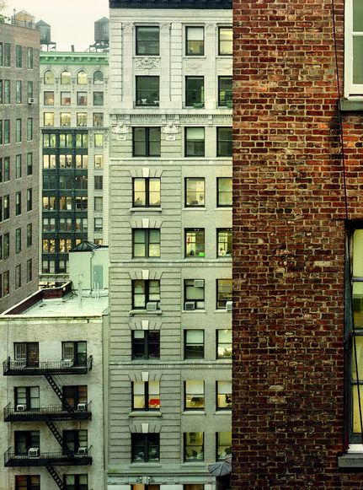
WHAT TYPE OF HARASSMENT ARE WE TALKING ABOUT TODAY?
LANDLORD HARASSMENT
By a landlord (or its agents)
Against a tenant (or a lawful occupant)
When the harassing behavior is intended to:
Cause the lawful occupant to vacate the apartment, OR
Cause the lawful occupant to surrender or waive occupancy-related rights

Slide 6
WHAT COUNTS AS LANDLORD HARASSMENT IN NYC?
Some more obvious behaviors that count as harassment against a lawful occupant (someone with permission to live in the apartment) :
BASICS
Using force or threatening to use force
​
Removing possessions ​
Removing or interfering with the door or the lock without giving a new key
​
Repeated contact or visits at odd hours​
Outside of 9 a.m. to 5 p.m.​
On Sat, Sun, or holidays
The following definition of landlord harassment in NYC comes from the
Housing Maintenance Code.
Notes:
Cora

Slide 7
WHAT COUNTS AS LANDLORD HARASSMENT IN NYC?
A LITTLE LESS BASIC
REPAIRS/CONSTRUCTION-RELATED
Threatening a person based on certain categories:
Age, race, immigration status, sexual orientation, source of income, status as a victim of sex offense, etc.
Requesting additional ID from someone who has already shown a government-issued ID
Giving the occupant false or misleading information regarding the occupancy of the unit
Repeated "baseless or frivolous" lawsuits
Repeated or extended disruptions of essential services
Repeated failures to repair class B or C violations
Repeated false certifications of a violation as repaired
Repeated work without a required construction permit
Failure to correct conditions that underly a vacate order
Making serious false or misleading statements about the rent stabilization status of a unit in applications for work on that unit
Notes:
Cora

Slide 8
RELATED TO BUYOUTS
Contacting someone to buy them out of the apartment without the required information (e.g., they have a right to a lawyer)
Contacting someone to buy them out of the apartment after that person has informed the owner in writing that they don't want buyout offers
Offering money to buy someone out while also:
Using intimidating or obscene language, or
Contacting that person too frequently, or
Contacting that person at their workplace, or
Giving false information to that person
WHAT COUNTS AS LANDLORD HARASSMENT IN NYC?
+ THE CATCH-ALL
repeated, significant acts that substantially interfere with the peace and quiet of an occupant
Notes:
Cora

Slide 9
ADDITIONAL DEFINITIONS OF HARASSMENT
HARASSMENT is anything that "interferes with, or disturbs, … the privacy, comfort, peace, repose or quiet enjoyment of the tenant … or is intended to cause the tenant to vacate … or not exercise any right afforded to the tenant under this Code"
To file a harassment claim with DHCR, tenants can fill out RA-60H, available online, and either mail it or hand it in person to DHCR.
A hearing will follow.
If DHCR finds that the landlord's behavior is harassment, it will impose a civil penalty on the landlord.
Additional meanings of harassment exist for
rent-stabilized tenants
Notes:
Cora

Slide 10
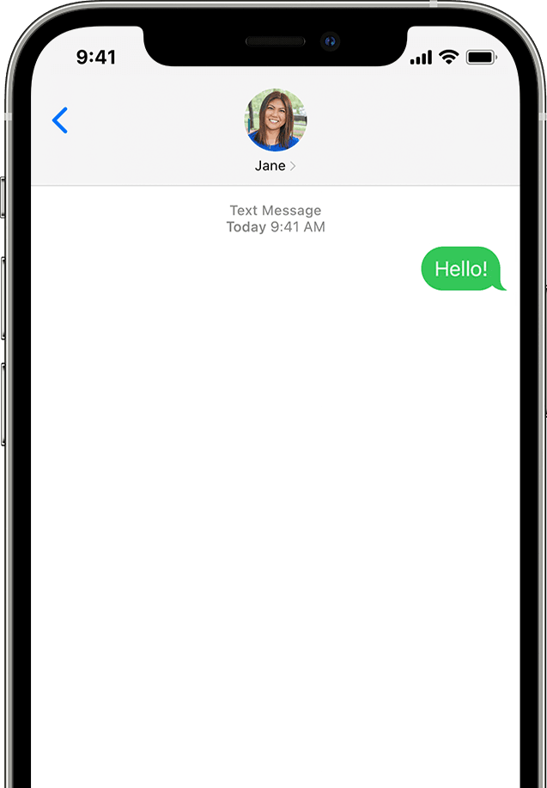
WHAT COMMON BEHAVIORS ARE GOING TO BE HARDER TO PROVE ARE HARASSMENT?
YOU MIGHT HAVE TO GET CREATIVE TO CONVINCE A JUDGE THE FOLLOWING COMMON LANDLORD BEHAVIORS ARE HARASSMENT:
You and the landlord arguing (without threats)
The landlord using swear words
The landlord being rude or disrespectful
The landlord insulting you
The landlord sending you notice that you owe rent every month that you owe rent

Slide 11
II.
HARASSMENT LAWSUITS IN HOUSING COURT
June 7, 2023
with Gale Brewer, District 6
Notes:
Cora

Slide 12
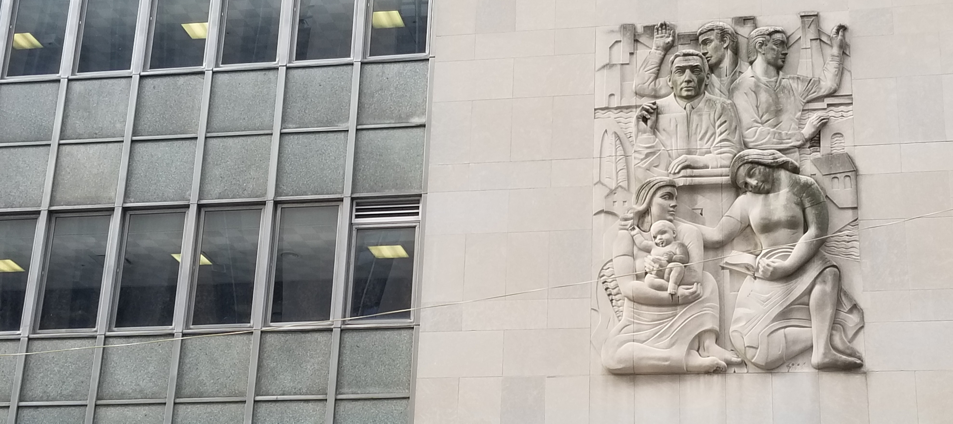
HP ACTIONS FOR HARASSMENT
HP actions are good for:
orders from a judge to stop the harassment.
HP actions aren't as good for: ​
compensation, especially for damaged or destroyed personal belongings. ​
Notes:
Ryan

Slide 13
WHAT CAN YOU GET OUT OF AN HP ACTION FOR HARASSMENT?
An injunction
- An order from a judge telling the landlord to cease the
harassing behavior
- Also called "injunctive relief"
Civil penalties
- The landlord might have to pay penalties to the city of
$2,000 to $10,000 per apartment
- If harassment has been found in the building in the
previous 5 years, then $4k-$10k per apt.
Compensatory damages or $1,000.00, plus attorneys' fees
Possibly: punitive damages
IF THE LANDLORD VIOLATES THE INJUNCTION:
- Actual damages (but you waive your right to sue for them), OR
- The costs and expenses caused by the violation of the order, plus $250
- Possibly: punitive damages
Notes:
Cora

Slide 14
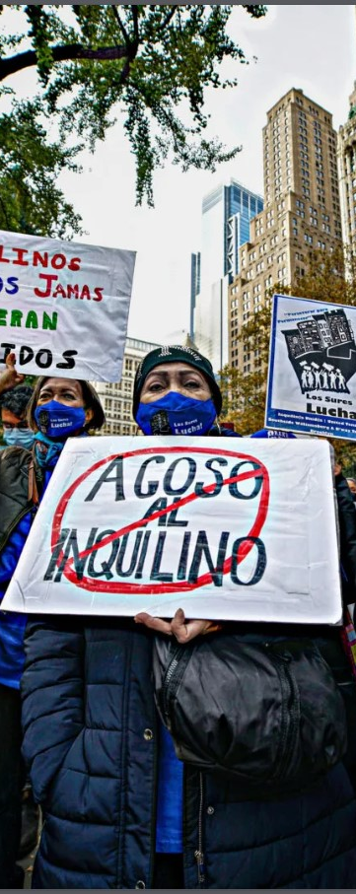
WHAT FACTORS MIGHT HELP YOU WIN YOUR HARASSMENT CASE?
If the harassment that occurred clearly falls into one of the types outlined in the slides before
Living in a building with three or more units
If you are willing to testify and show up to court – even though court dates are often inconvenient and unfairly scheduled
Teaming up and filing together with other tenants in your building
PROOF! – especially from government agencies
HPD violations are required for HP harassment claims that are related to a physical problem in the building
Notes:
Cora

Slide 15
WHAT ABOUT RETALIATION?
For one year after you stand up for your rights by:
Asking your landlord for repairs
Calling 311 to report a repair problem or
Filing a lawsuit against your landlord
-- if your landlord tries to evict you, you can say the eviction is illegal retaliation.
Note that if the landlord can come up with a plausible, non-retaliatory reason for ending your tenancy or refusing to renew your lease, it might be hard to prove retaliation.
Notes:
Cora

Slide 16
III.
HP ACTIONS
STEP-BY-STEP
June 7, 2023
with Gale Brewer, District 6
Notes:
Cora

Slide 17
THE LIFESPAN OF A HARASSMENT CASE
END (AGAIN)
BEGINNING
- File papers
- Inspection
- 1st, maybe 2nd court date
- Time for landlord to answer
- Request an interim order
END
- Settlement
OR
- Trial
- Decision after trial
If you win: Order from the court!!
MIDDLE
- Maybe 2nd, 3rd, 4th court dates
- Trial
- Some harassment has to die twice
- Contempt
Notes:
Ryan

Slide 18
Step 1.
SOME FORMS OF EVIDENCE​
Government records:
From HPD, DOB, etcetera
Living in a building with three or more units
A police report*
Written records
Texts
Letters
Emails
Video
Testimony
GATHER YOUR EVIDENCE
Notes:
Cora

Slide 19
GETTING STARTED
Step 2.
Tell the clerk you want to start an HP action for harassment
Fill out an ORDER TO SHOW CAUSE
Other forms:
Fee waiver form – or $45.00 (no personal checks or cards)
Inspection request (if there are physical conditions)
Possibly: fill out a statement explaining the harassment briefly but with detail
You will get:
An inspection date if you requested an inspection – usually about 1 week from filing - you must be at home!
A court date – usually 10 days after inspection
Serve the forms on the landlord ASAP!
Find the landlords' names and addresses by looking them up on hpdonline or whoownswhat.nyc
Must be by certified mail
Keep your certified mailing receipt and all related receipts
Notes:
Cora

Slide 20
GOING TO COURT
Step 3.
First court date
The court will make sure you served the landlord correctly
If not, they will dismiss the case and you'll have to start over
If the landlord isn't there, you can ask for a "default judgment," but the court might just set a new court date instead
The judge might not be there – you'll get a new court date
If both sides are there, the judge or court might encourage you to come to an agreement/settlement, or to try to do so before the next court date
The next court might be in 3 weeks – roughly
Future court dates:
If you haven't come to an agreement/settlement with the landlord, be ready to show the court your evidence
Notes:
Cora

Slide 21
Step 4.
TWO ROADS TO WINNING YOUR CASE
You can come to a settlement agreement where the landlord agrees not to do the harassing behavior for a certain time period.
Or, instead, you can continue to ask the judge for an order telling the landlord to stop – you will probably have to win at trial to get this.
Both a settlement agreement and an order have the same seriousness – they are both considered orders of the court.
Notes:
Cora

Slide 22
IF THE LANDLORD DISOBEYS THE ORDER
Contempt
If the landlord violates the order or the settlement agreement, you can file an Order to Show Cause to hold the landlord in contempt of court
Once you file the OSC, a court date will be scheduled
Think carefully about what type of proof you can present of the landlord's violation
You can ask for compensation for the costs or damages (if you have receipts or bills) you suffered because the landlord violated the order
Notes:
Ryan

Slide 23
RESOURCES
HPD Online: https://hpdonline.nyc.gov/hpdonline/
Look up your address to find the names of the landlord and the managers and their addresses
Follow up on violations placed by 311 for physical conditions in the building
Whoownswhat.nyc -- find out even more about your building!
Met Council on Housing: www.metcouncilonhousing.org/help-answers/hp-actions-for-repairs-and-services/
Not harassment-specific, but helpful for filing an HP in general
DHCR
Factsheet on harassment for rent-stabilized tenants: https://hcr.ny.gov/system/files/documents/2023/11/fact-sheet-17-11-2023.pdf
QUESTIONS? COMMENTS?
Notes:
https://housingcourtanswers.org/
https://www.metcouncilonhousing.org/help-answers/
https://assets.nationbuilder.com/righttocounselnyc/pages/1342/attachments/original/1664821814/Right_to_Counsel_-_Tenant_Self_Defense_Resource_Guide_-_FINAL.docx_%281%29.pdf?1664821814
https://www.righttocounselnyc.org/
https://www.justfix.org/en/

